Slide 1
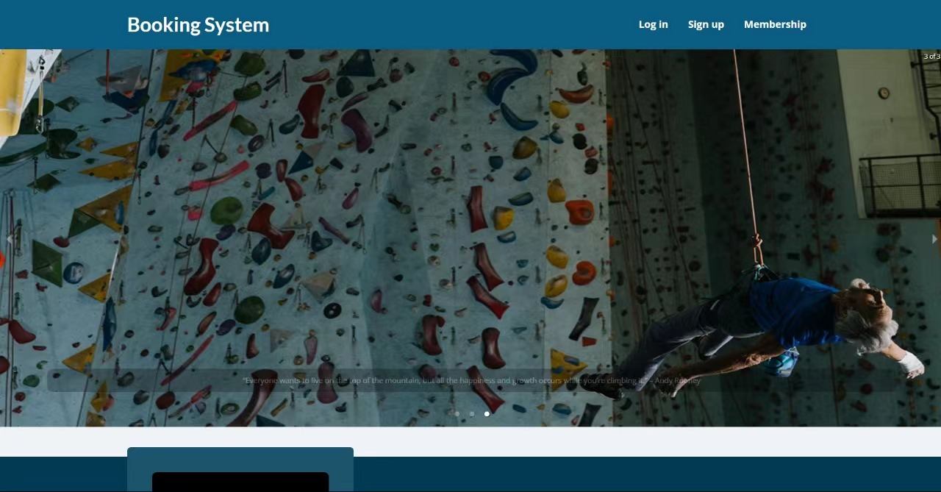
Booking Management System
Software Engineering Project
Dhurba Tripathi (dt2202)
Yi Wang (yw4549)
Presented To:
Professor Mai Oudah

Slide 2
Content
Implementation and Testing
Communication and Planning
02
04
Need for the system
01
03
05
System Modelling
Demo

Slide 3


The need for an online booking system
Traditional methods of booking: phone calls, emails - very tedious (Problem of: No show)
Online booking - user convenience and customer satisfaction
Attract more climbers/ climbing enthusiasts by utilizing internet technology and publicity

Slide 4
Communication and Planning
Implementation and testing
Modeling
Requirement gathering
Economic feasibility
Project size
Work plan
Use case diagram
Class diagram
Activity diagram
Sequence diagram
Design test cases
Implement a demo
Test the demo

Slide 5
Communication and planning
01
Requirement gathering
Economic feasibility
Project size
Work Plan

Slide 6

Requirement Gathering
Motivation
Q1: Why do you need a online booking system?
-It’s much more convenient than booking by calls.(3)
-It saves our money as phone calls are not free.(1)
Basic Functions
Q2: Is it fine for you that you will be warned of not showing?
-Yes.(0)
-No.(3) Make us pay in advance will solve the problem.
Q3: What do you want us to do if the date and time you want to book is full?
-Nothing.(1)
-Add us to waitlist and inform us once someone cancels the booking.(2)
Q4: Is it fine for you that you will receive automatic emails once the order is completed?
-Yes.(3)
-No.(0)
Supplement Functions
Q5: Any functions apart from basic ones you want to add? (describe those already in mind)
-Book a coach. Additional fees or membership only.
-It’s annoying to explain what I need every time. Can you add a function that I can just input the requirements and then they will know.
-Can you use the nfc technique to mark the routes and I can check them with my phone?
Interview

Slide 7
SRS Summary
Create a user account
Make a booking
Sign up for membership
Coach login
Admin login
1. Login to the system
2. Pick a date and time
3. Book a coach
4. Stay in waitlist if currently not available.
1. Select membership type
2. Promo codes for discounts
3. Payment
4. Confirmation message
1. Login to the system
2. View the timings for which they are booked
3. Mark available timings
4. View the hours of past sessions coached
1. Login to the system with two factor authentication
2. View all bookings
3. Manage coach accounts
1. Information form
2. Error checking
3. Verification code via Email
1
2
3
4
5

Slide 8
Economic Feasibility
Costs | Period1 | Period2 | Period3 | Period4 | Period5 | Period6 | Total
Salaries | 20 | 20 | 20 | 20 | 0 | 0 | 80
H/W & S/W | 20 | 0 | 0 | 0 | 0 | 0 | 20
Training | 30 | 0 | 0 | 0 | 0 | 0 | 30
Support and Maintenance | 0 | 0 | 0 | 0 | 10 | 10 | 20
Total costs | 70 | 20 | 20 | 20 | 10 | 10 | 150
Benefits
Increase # of customers | 0 | 0 | 0 | 0 | 300 | 300 | 600
Decrease costs | 0 | 0 | 0 | 0 | 30 | 30 | 60
Total Benefits | 0 | 0 | 0 | 0 | 330 | 330 | 660
NCF | (70) | (20) | (20) | (20) | 320 | 320 | 510
CNCF | (70) | (90) | (110) | (130) | 190 | 510 | 1020
Numbers are in thousands of DHS
NCF: Net Cash Flow
CNCF: Cumulative Net Cash Flow
One period corresponds to two weeks
H/w and S/w correspond to Hardware and Software respectively

Slide 9
Economic Feasibility
The return on investment (ROI):
ROI = (Total Benefits - Total Costs) / Total Costs
= (660-150)/150
=340 %
The break-even point (BEP):
BEP = (Period.net cash flow - Cumulative.net cash flow) / Period.net cash flow
= (320-190)/190 = 68%
= 0.68*1*14 =9.50 ≈ 10 days
So the Project will take 8 weeks and 10 days which is 56 days.
Conclusion:
The ROI is good for this booking system, and the BEP is only a bit greater than the reality.
So the risk is relatively low.

Slide 10
Project Size
Functionality | Input | Output | Queries | File | Interface
Registration | 3 | 2 | 1 | 1 | 0
Login | 2 | 1 | 1 | 1 | 0
Booking | 1 | 1 | 1 | 1 | 0
Payment | 1 | 1 | 1 | 1 | 1
Membership | 1 | 1 | 1 | 1 | 0
Notification | 0 | 1 | 3 | 1 | 0
Function Point Estimation
Information domains | Count | Weighting Factor |  |  | Total
 |  | Simple | Average | Complex
EIs | 8 | 4*3 | 3*4 | 1*6 | 30
EOs | 7 | 4*4 | 3*5 | 0*7 | 31
EQs | 8 | 2*3 | 3*4 | 3*6 | 36
ILFs | 6 | 2*7 | 4*10 | 0*15 | 54
EIFs | 1 | 0*5 | 1*7 | 0*10 | 7
Total Unadjusted Function Points (TUFP) = |  |  |  |  | 158

Slide 11
Project Size
The adjusted processing complexity (APC)
APC = 0.65 + (0.01 * TPC)
APC = 0.65 + (0.01 * 16) = 0.81
The total adjusted function points (TAFP)
TAFP = TUFP * APC = 158 * 0.81 = 127.98
Converting Function Points to Line Of Code (LOC)
• 70% will be done in Javascript
• 30% will be done in HTML and CSS (for layouts only)
Number of lines of code (LOC) = TAFP * # of (LOC\FP) * %
For Javascript = (127.98) *(71.11)*(70/100) = 6370.46 LOC
For HTML/CSS = (127.98) *(15)*(30/100) = 575.91 LOC
So the total LOC = 6946.37 LOC = 6.95 KLOC
Estimating the effort
Effort
= 2.4 * KLOC1.05
= 2.4 * 6.951.05
= 18.38
Estimating the schedule time
Time
= 2.5 * (effort)0.38
= 2.5 * (18.38)0.38 = 7.55
Estimating the number of persons
average of # of persons
= effort/time
= 18.38 / 7.55 = 2.43 persons
The total processing complexity (PC)
Tasks | Complexity
Familiarity with technology | 2
Online data entry | 2
​​Data communication | 3
Transaction rate | 2
Multiple sites | 2
Performance | 3
Operating ease | 2
Total Processing Complexity (TPC) = | 16
*Complexity is from 0 to 3: (0 = no effect on project complexity; 3 = great effect on project complexity)

Slide 12
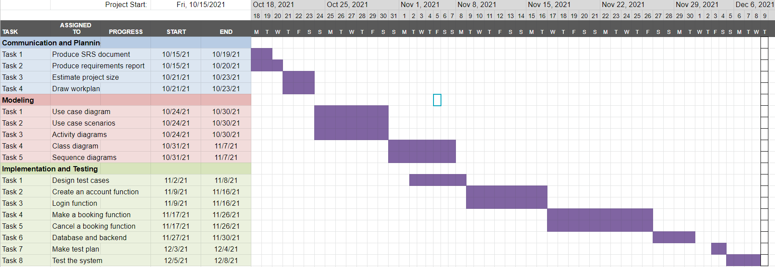
Work Plan (Gantt Chart)

Slide 13




Risk Analysis
Lack of Technical Experts and small team size
Time constrainsts
Semi-familiarity with technologies to use.
Lack of free training / funding, for required skills is unavailable
Scale of the project is underestimated

Slide 14
System Modelling
02
Use case diagram
Class diagram
Activity diagram
Sequence diagram

Slide 15
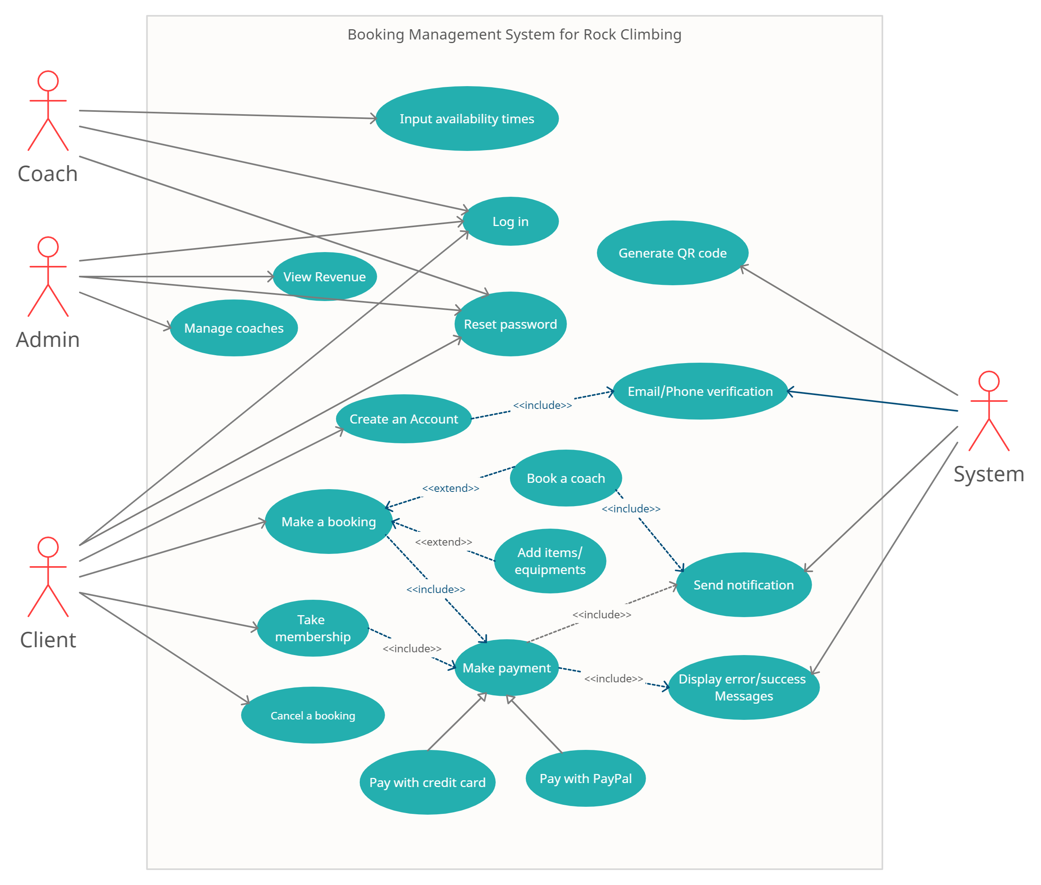
Use Case Diagram

Slide 16
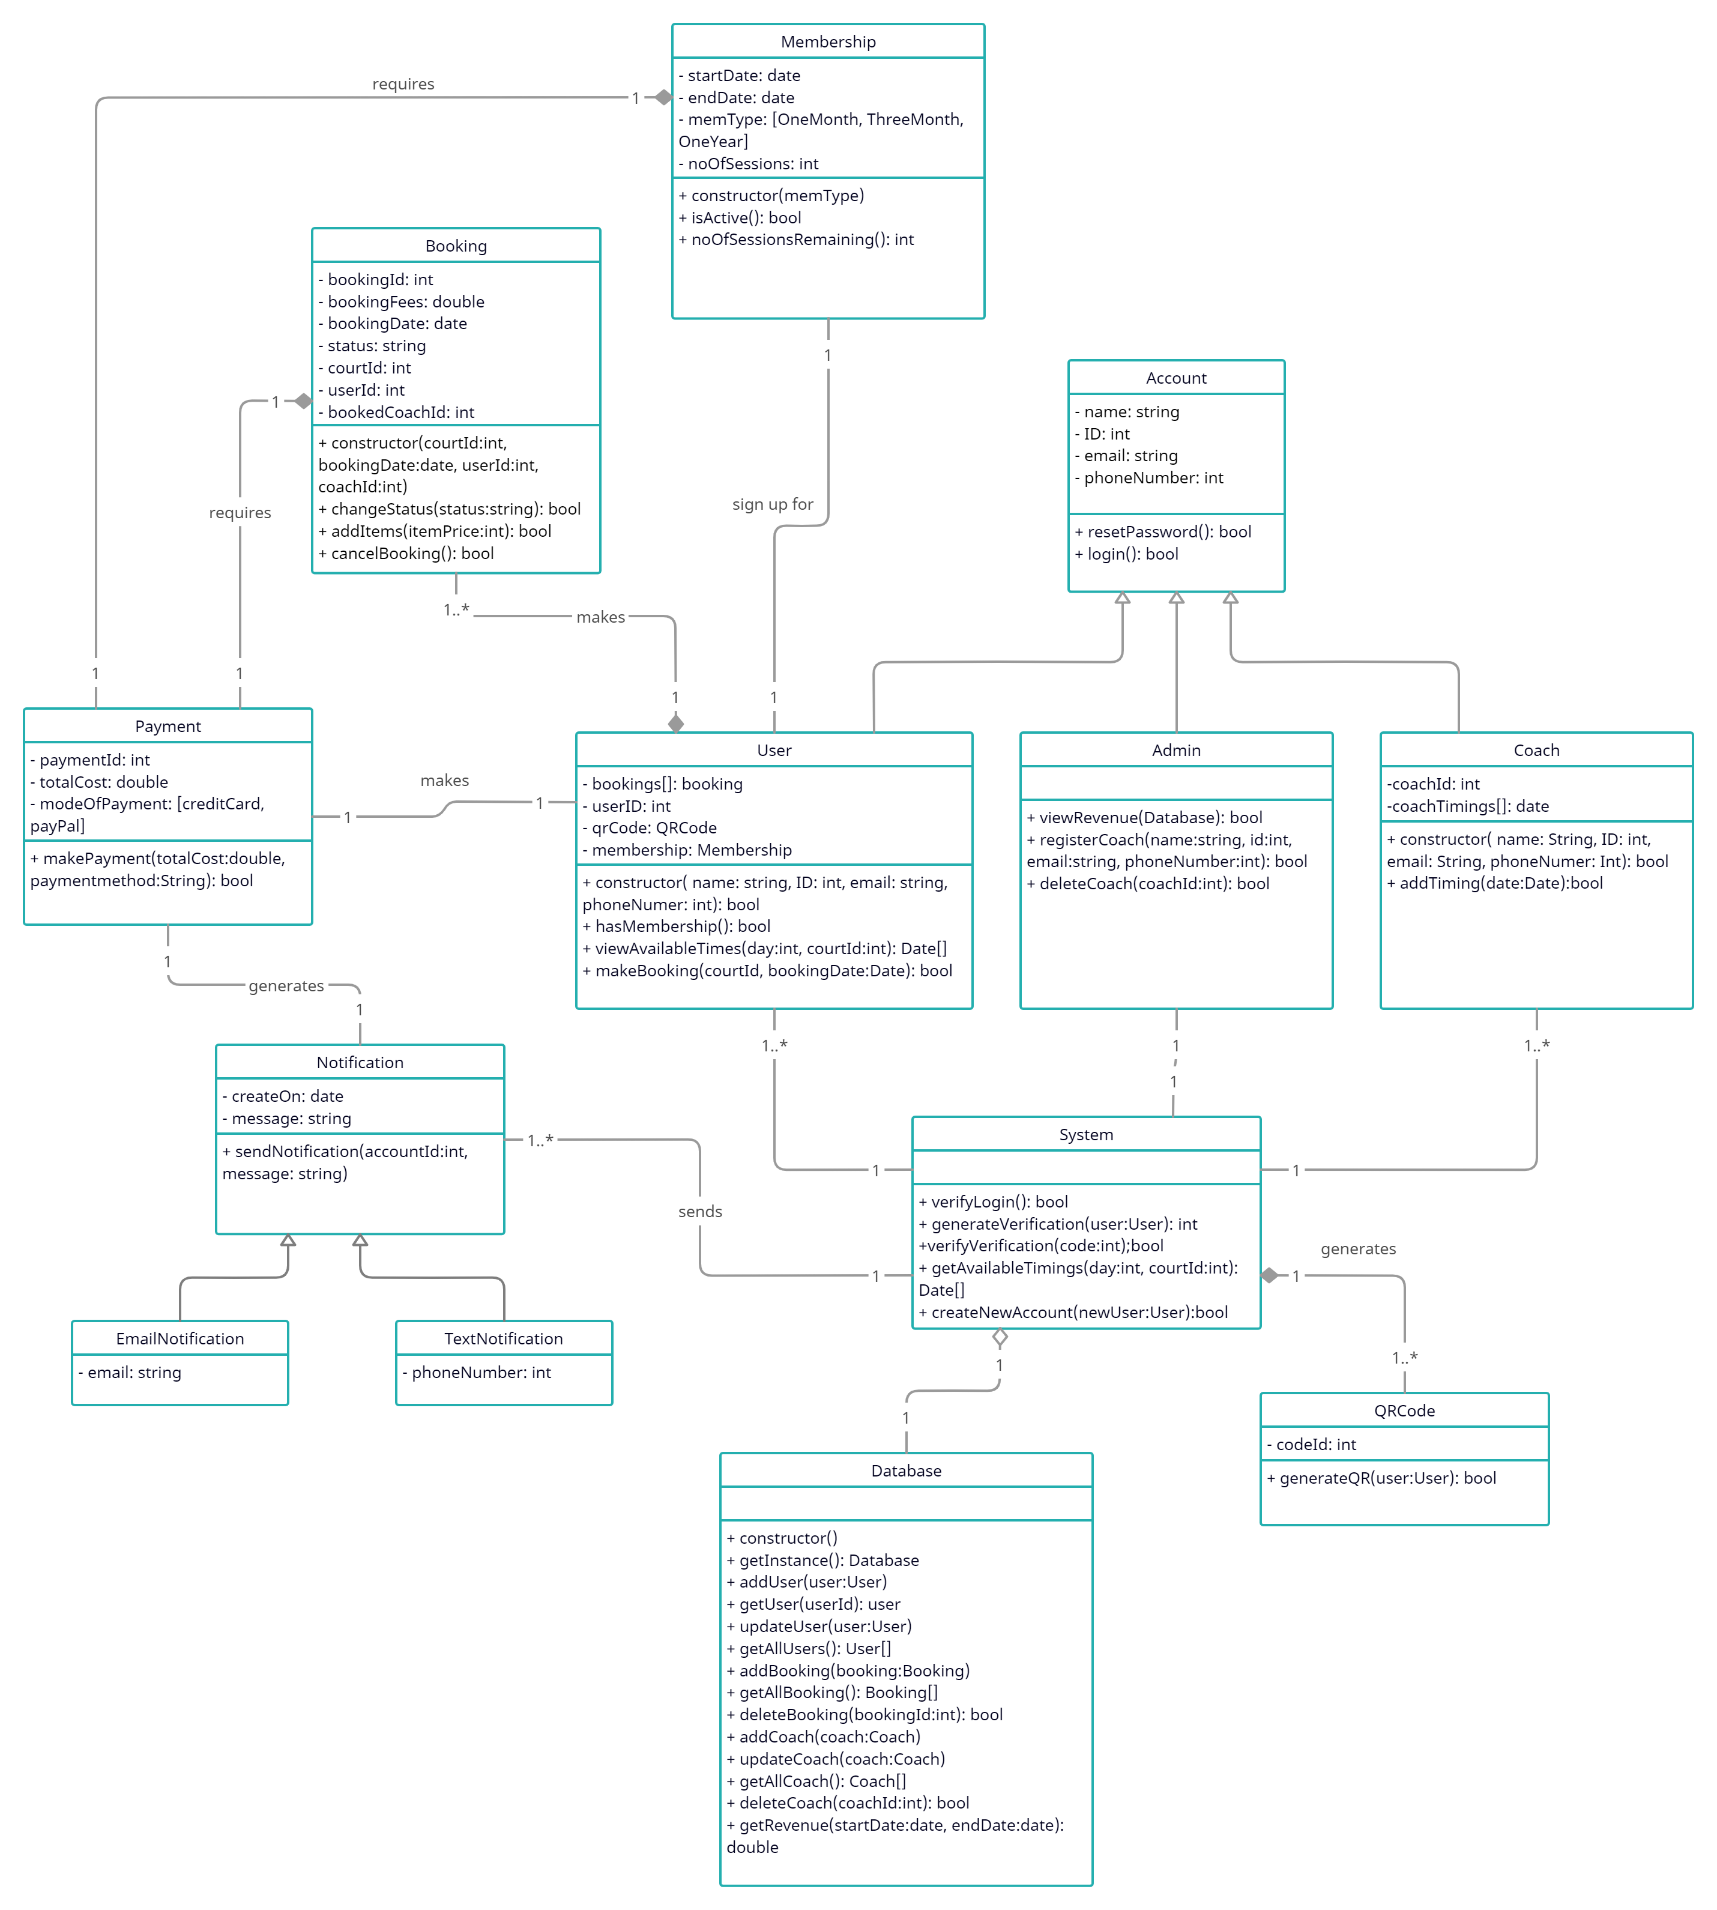
Class Diagram

Slide 17
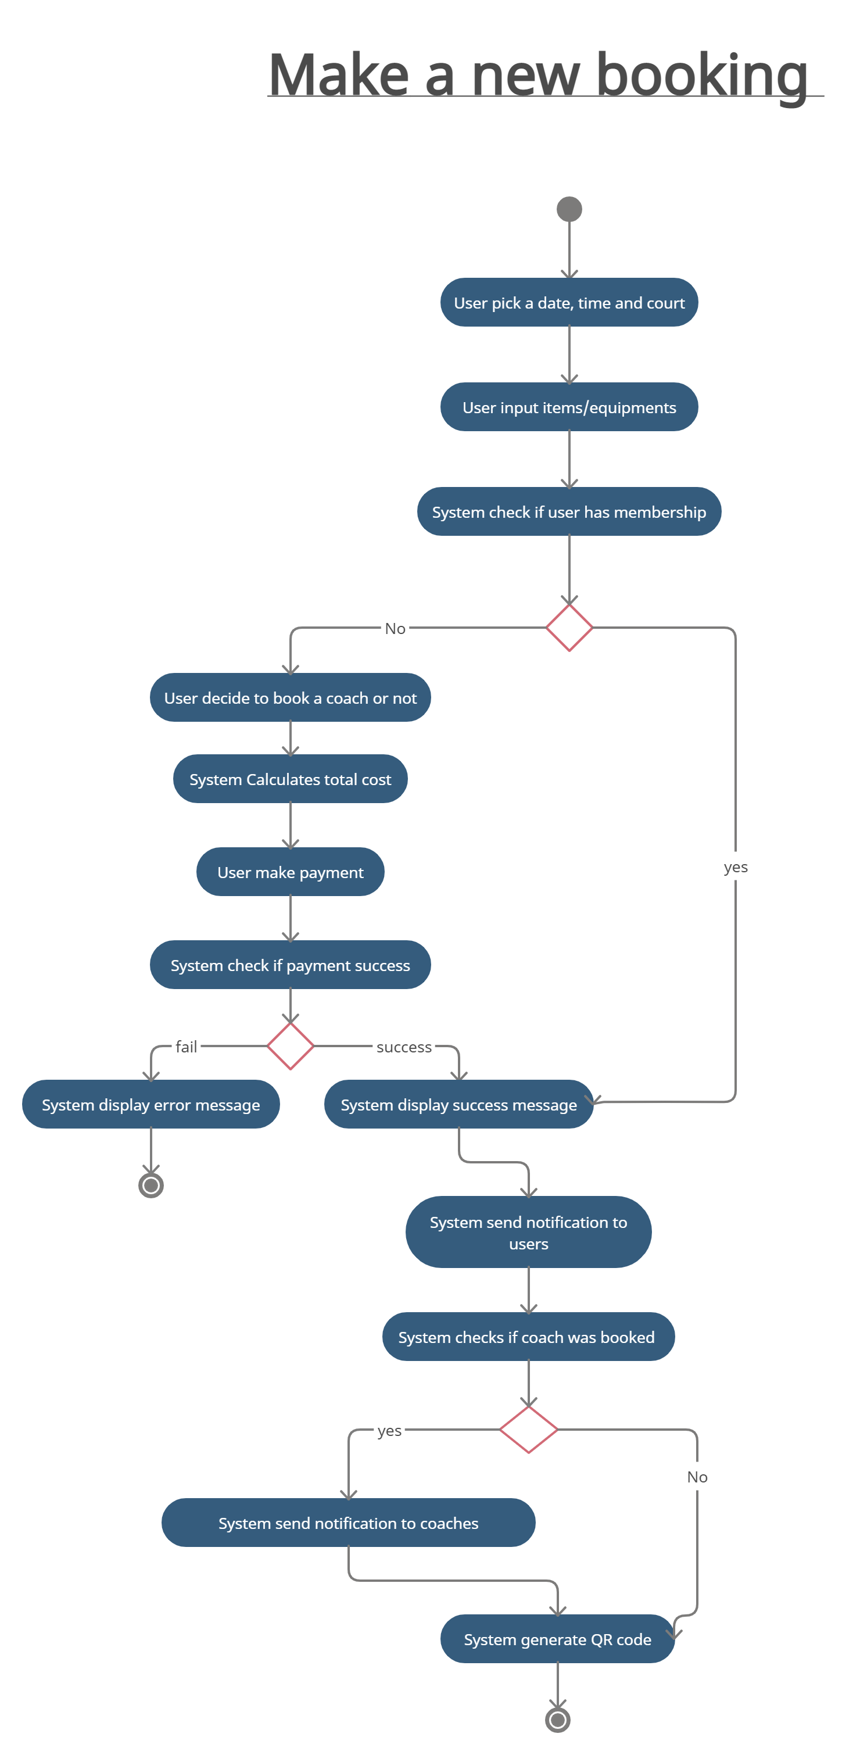
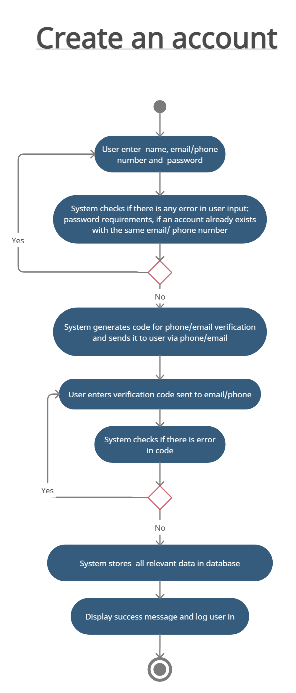
Activity Diagrams

Slide 18
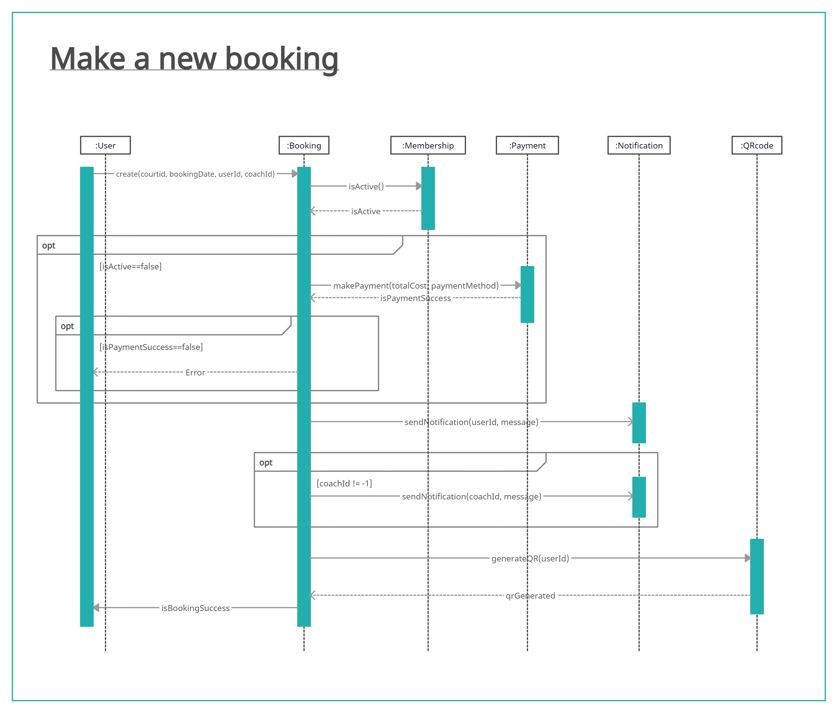
Sequence Diagrams

Slide 19
Implementation and Testing
03
Design test cases
Implement a demo
Test the demo

Slide 20




Implementation
Technologies
Authentication
Html, Css,
Javascript, ReactJs
Firebase
Google Firebase Authentication
Database
Google Firebase Realtime Databse

Slide 21
Testing
Test cases | Priority | Bug step | Solution
1. Make a non-membership booking (available). | High | No bugs | Success
2. Make a non-membership booking (not available). | Medium | No bugs | Success
4. Notify those in a waitlist of a new slot. | Medium | Failure | Yet to implement
5. Make a coach booking | High | No bugs | Success
6. Cancel a booking | High | No bugs | Success
7. Create a new account | High | No bugs | Success
8. Sign up for membership | High | Failure | Yet to implement
9. User login and logout | High | No bugs | Success
10. Operations for coach | Medium | Failure | Yet to implement
11. Operations for admin | Medium | Failure | Yet to implement

Slide 22
04
DEMO

Slide 23
Thanks for watching !

